Slide 1


Name: Sumesh Gareri
Date: 15 July 2025

Slide 2

Outline
Executive Summary
Introduction
Methodology
Results
Conclusion
Appendix

Slide 3
Executive Summary
Summary of methodologies:
Collected launch data using the SpaceX API and supplementary web scraping.
Performed data cleaning, wrangling, and preprocessing to prepare the dataset.
Conducted exploratory data analysis (EDA) using SQL queries and Python-based visualization tools.
Developed interactive maps and dashboards to analyze launch trends and insights.
Built predictive models using machine learning classification algorithms to estimate launch success.
Summary of all results
Identified factors influencing Falcon 9 first stage landings.
Visualized geographical patterns and success rates.
SAM and K-Neighbors: 88.33% accuracy.
Launch sites and payload mass impact landing success.
Decision Tree model is the most effective predictor.

Slide 4
Introduction
Background and Context
SpaceX, founded by Elon Musk in 2002, is a private aerospace company that aims to revolutionize space technology and reduce the cost of space travel. One of its most successful innovations is the Falcon 9, a reusable launch vehicle designed to carry satellites and cargo to orbit. By mastering rocket reusability, SpaceX has significantly lowered launch costs and transformed the global space industry.
As part of the IBM Data Science Capstone Project, learners analyze real historical data from Falcon 9 launches to predict the likelihood of a rocket’s first-stage landing successfully. This prediction is important because successful landings directly reduce launch costs and improve mission reliability. Through this project, various data science techniques such as data collection, data wrangling, exploratory data analysis (EDA), machine learning modeling, and visual analytics are applied to create insights and build predictive models.
Problems you want to find answers
Which factors influence the success or failure of the Falcon 9 first-stage landing?
Accurately predicting whether a Falcon launch will result in a successful landing?
Which machine learning model performs best in predicting the landing success?

Slide 5

Section 1

Slide 6
Methodology
Executive Summary
Data Collection Methodology:
Historical Falcon 9 launch data was gathered from the SpaceX REST API and Wikipedia tables.
Key attributes collected include launch date, payload mass, orbit type, launch site, and landing outcome.
Data Wrangling:
Cleaned missing values, standardized formats, and removed inconsistencies.
Engineered features and encoded categorical data for analysis.
Exploratory Data Analysis (EDA):
Conducted statistical and visual analysis using SQL, matplotlib, and seaborn.
Identified relationships between payload mass, orbit category, launch site, and landing success.

Slide 7
Methodology
Interactive Visual Analytics:
Developed Folium-based maps to display launch site distribution and outcomes.
Built interactive dashboards using Plotly Dash for dynamic data exploration.
Predictive Analysis Using Classification Models:
Built and evaluated models such as Logistic Regression, SVM, Decision Trees, and KNN.
Performed hyperparameter tuning and assessed performance using accuracy and F1 scores.

Slide 8
Data Collection
SpaceX REST API
The SpaceX API provides structured JSON data about all Falcon 9 launches.
Using Python (with requests library), API endpoints were called to extract details such as:
Launch date
Rocket type
Payload mass
Orbit
Launch site
Landing success/failure
This ensured the data was accurate, up-to-date, and machine-readable.
Wikipedia HTML Tables
Some fields, such as detailed payload information or missing values, were not fully available in the API.
Additional launch details were scraped from Wikipedia’s Falcon 9 launch record tables using pandas.read_html().
This helped fill gaps in the dataset, ensuring a more complete and reliable dataset.
Data Integration
The data obtained from both sources was combined, cleaned, and standardized.
Duplicate entries were removed and inconsistent formats were corrected before analysis.

Slide 9
Data Collection – SpaceX API
Access SpaceX API
Fetched Falcon 9 launch data using Python API call.
Extract Key Fields
Retrieved launch dates, sites, payload mass, orbit, and landing outcome.
Collect Wikipedia Data
Scraped launch tables to fill missing details.
Merge Both Sources
Combined API + Wikipedia data into one dataset.
Clean Dataset
Removed duplicates, fixed formats, handled missing values.
Save Final Dataset
Stored clean DataFrame for EDA and modeling.
Access SpaceX API
Extract Key Fields
Collect Wikipedia Data
Merge Both Sources
Clean Dataset
Save Final Dataset
GitHub: 1_spacex-data-collection.ipynb

Slide 10
Data Collection - Scraping
Identify Web Source
Locate Falcon 9 launch tables on Wikipedia containing mission details.
Confirm table structure and fields needed (date, payload, orbit, outcome).
Extract HTML Tables
Use pandas.read_html() to automatically read and convert tables into DataFrames.
Select the correct table containing launch records.
Parse Scraped Data
Clean column names and remove unwanted rows.
Extract key fields (payload name, orbit category, mission type, etc.).
Handle Missing / Inconsistent Data
Fix formatting inconsistencies from scraped text (units, dates, strings).
Fill missing values using API data or logical corrections.
Store Data Locally
Convert cleaned tables into a single DataFrame.
Save as .csv or keep in memory for merging with API data.
Identify Web Source
Handle Missing / Inconsistent Data
Store Data Locally
Extract HTML Tables
Parse Scraped Data
GitHub: 2_webscraping.ipynb

Slide 11
Data Wrangling
Key Phrases to Describe the Process
Load raw data from API output and scraped tables
Inspect dataset structure (columns, types, missing values)
Clean missing values (remove, fill, or impute)
Standardize formats (dates, units, text categories)
Convert data types (strings → numeric, dates → datetime)
Encode categorical variables for modeling
Remove duplicates and irrelevant columns
Merge API + Wikipedia datasets
Create new engineered features (landing success label, orbit class)
Export cleaned dataset for EDA & modelling
GitHub: 3_spacex-Data wrangling.ipynb

Slide 12
Data Wrangling Flowchart
Raw Data (API + Scraped Data)
Standardize Formats (dates, units, categories)
Convert Data Types (numeric, datetime)
Inspect Data Structure (columns, missing values)
Clean Missing & Incorrect Values
Merge API + Wikipedia Tables
Feature Engineering (landing success, orbit class)
Remove Duplicates & Unnecessary Columns
Final Cleaned Dataset Ready for EDA & Modeling

Slide 13
EDA with Data Visualization
Overview:
EDA helps us understand the data by using simple charts to spot patterns, trends, and relationships. Visualizing the data makes it easier to identify important features and prepare the dataset for modeling.
Charts Plotted:
1. Bar Charts
Used for: Comparing landing success counts across different launch sites.
Why: Bar charts clearly show categorical comparisons and help identify which sites have higher success rates.
2. Scatter Plots
Used for: Analyzing the relationship between payload mass and landing success.
Why: Scatter plots help identify trends, clusters, and correlations between two numeric variables.
3. Pie Charts
Used for: Showing the proportion of successful vs. failed landings.
Why: Pie charts provide a quick view of distribution and overall success ratio.
GitHub: 5_EDA-data-viz.ipynb

Slide 14
EDA with Data Visualization
4. Line Charts
Used for: Observing how launch success trends have changed over time.
Why: Line charts clearly show time-series patterns and improvements in success rate across years.
5. Heatmaps (Correlation Matrix)
Used for: Displaying correlations between variables such as payload mass, orbit type, flight number, and landing success.
Why: Heatmaps visually highlight strong or weak relationships that guide feature selection for ML models.
6. Box Plots
Used for: Analyzing the spread of payload mass across different orbit types.
Why: Box plots show outliers, medians, and variation, helping understand payload distribution.

Slide 15
EDA with SQL
EDA with SQL involves using SQL queries to explore, clean, and understand the dataset directly in a database.
By applying commands like:
SELECT Queries: View specific columns such as payload, orbit, launch site, and landing outcome.
WHERE Filters: Filter launches by payload mass, orbit type, or success status.
GROUP BY: Calculate landing success rates across launch sites and orbit categories.
Aggregate Functions: Use COUNT, AVG, MAX to summarize launch performance.
ORDER BY: Sort data by payload mass, date, or success probability.
JOIN Queries: Combine tables to enrich launch data (if stored separately).
LIMIT: Preview a subset of rows for quick inspection.
SQL makes it easy to inspect large datasets efficiently before performing deeper visual analysis or building machine-learning models.
GitHub: 4_EDA-SQL.ipynb

Slide 16
Build an Interactive Map with Folium
Summary of Map Objects Added to the Folium Map
1. Markers
What was added: Standard Folium Markers were placed at each SpaceX launch site location (e.g., CCAFS LC-40, KSC LC-39A, VAFB SLC-4E, Boca Chica).
Why:
To visually pinpoint the exact geographic position of each launch site.
Markers help users clearly identify where SpaceX launches occur on the map.
2. Circle / CircleMarker
What was added: Circular overlays (often with radius and color coding).
Why:
To highlight the area surrounding a launch site.
Used to show nearby interest zones (e.g., proximity to the coast, nearby cities).
Provides an immediate visual boundary or emphasis around important locations.
3. Polyline (Lines)
What was added: Lines connecting launch sites to their nearest cities or between coordinates.
Why:
To visualize distances or routes.
Helps interpret spatial relationships, e.g., how far a launch site is from a major landmark.
Useful for analysis tasks like “calculate and show the flight path/distance”.
GitHub: 6_launch_site_location.ipynb

Slide 17
Build a Dashboard with Plotly Dash
Launch Success Pie Chart
What was added: A pie chart showing the proportion of successful vs failed Falcon 9 launches.
Why:
Gives an immediate snapshot of SpaceX’s overall success rate.
Helps viewers visually understand the reliability of Falcon 9.
2. Launch Outcomes by Site (Bar Chart)
What was added: A bar chart comparing success/failure counts across all launch sites.
Why:
Useful for identifying which launch sites perform better.
Helps answer questions like “Which launch site has the highest success rate?”
Supports later predictive analysis.
3. Payload vs Launch Outcome Scatter Plot
What was added: A scatter plot showing the payload mass (kg) vs. the launch success/landing result.
Why:
Reveals whether heavier payloads affect success probability.
Helps explore the relationship between payload mass and landing outcome.
Important for model understanding before prediction.

Slide 18
Build a Dashboard with Plotly Dash
4. Booster Version Performance Line/Bar Chart
What was added: A chart showing how different booster versions performed over time.
Why:
Visualizes upgrade improvements across Falcon 9 variants.
Shows patterns (e.g., newer boosters more reliable).
5. Interactive Payload Slider
What was added: A slider to filter data by payload mass range.
Why:
Allows users to explore how launch outcomes vary for lighter vs heavier payloads.
Makes the dashboard dynamic and customizable.
6. Launch Site Dropdown Menu
What was added: A dropdown to select a specific launch site.
Why:
Allows users to view site-specific performance.
Makes comparisons between sites easy and interactive.
GitHub: 7_dash_app.py

Slide 19
Predictive Analysis (Classification)
Data Splitting: Divided the dataset into training and testing sets to ensure fair evaluation.
Baseline Models: Tried simple models first (e.g., Logistic Regression, Decision Tree) to understand initial performance.
Model Training: Fit multiple classification models using cleaned and encoded features (payload mass, site, booster version, etc.).
Hyperparameter Tuning: Improved model performance using techniques like GridSearchCV or parameter optimization.
Evaluation: Compared models using Accuracy, Precision, Recall, and Confusion Matrix.
Best Model Selection: Selected the model with highest accuracy and best generalization on the test set.
Final Improvement: Tuned the winning model further and validated to ensure consistent performance.
GitHub: 8_SpaceX_Machine Learning Prediction.ipynb

Slide 20
Predictive Analysis (Flowchart)
Data Preparation
Train-Test Split
Evaluate Metrics
Train Baseline Models
Hyperparameter Tuning
Select Best Model
Compare All Models
Final Validation & Save Model

Slide 21
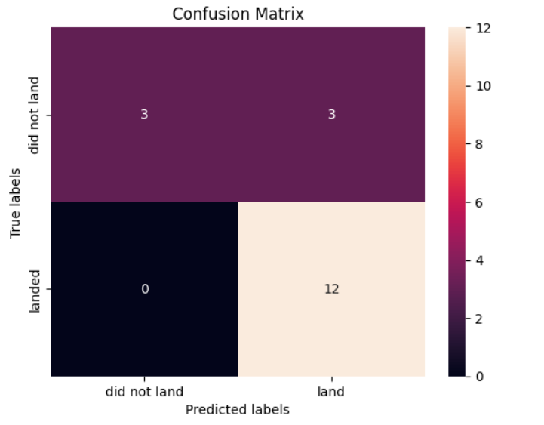
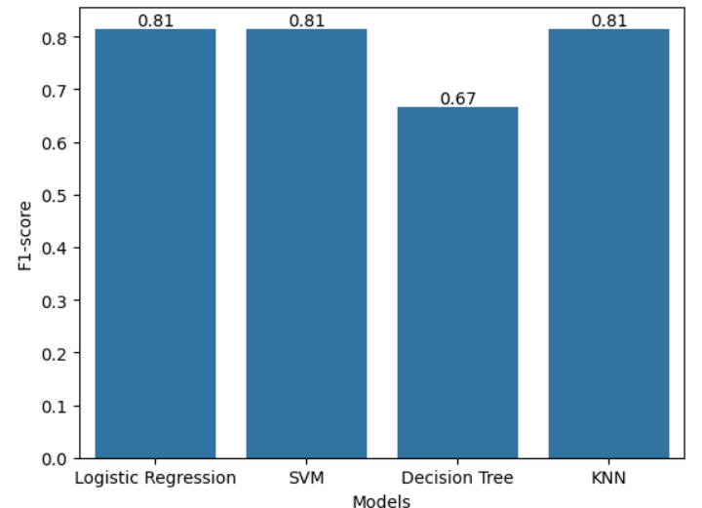
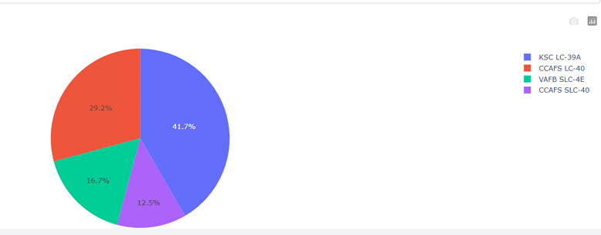
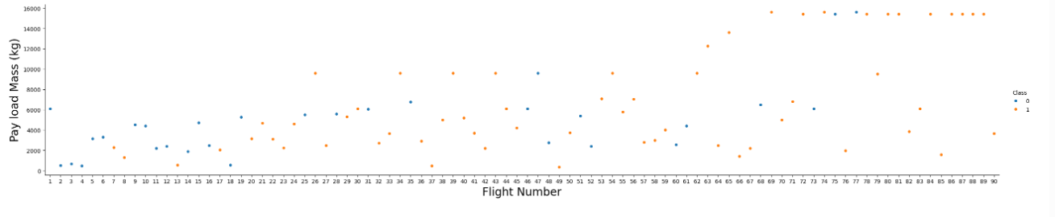
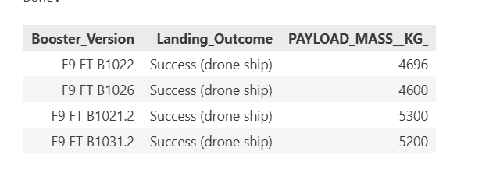
Results
Exploratory data analysis results
Interactive analytics demo in screenshots
Predictive analysis results

Slide 22

Section 2

Slide 23
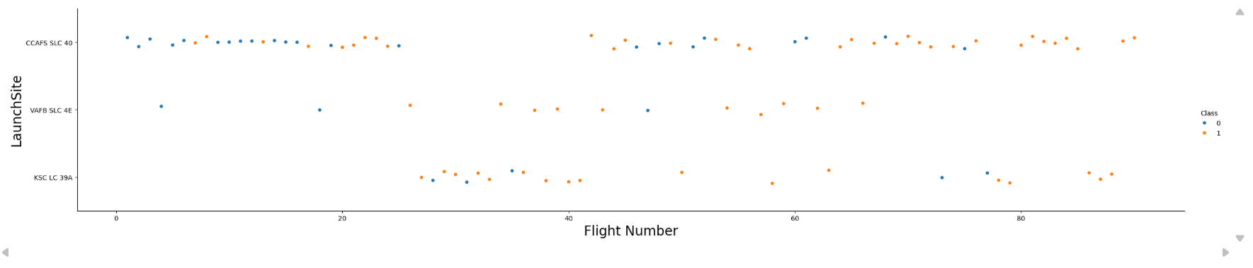
Flight Number vs. Launch Site
Explanation
This scatter plot shows the relationship between Flight Number and Launch Site, with each point representing a Falcon 9 launch. The color indicates the launch outcome:
Blue (0) → failed landing
Orange (1) → successful landing
The plot helps us observe how success rates vary across different launch sites and how performance improves over time as flight numbers increase. It also shows that some sites (like KSC LC-39A) have a higher concentration of successful landings compared to others.

Slide 24
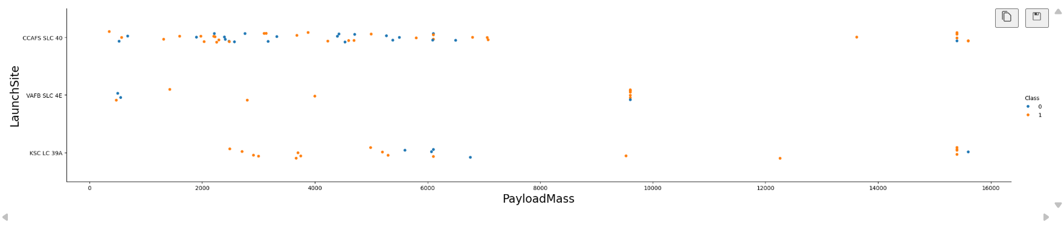
Payload vs. Launch Site
Explanation
This scatter plot shows the relationship between Payload Mass and Launch Site, with each point colored by launch outcome (blue = failure, orange = success).
The plot helps us see how different payload weights perform at each site. We can observe that successful landings (orange) occur across a wide range of payload masses, especially at CCAFS SLC-40 and KSC LC-39A. Heavier payloads generally still achieve high success rates, indicating strong Falcon 9 reliability across different mission sizes.

Slide 25
Success Rate vs. Orbit Type
Show a bar chart for the success rate of each orbit type
Show the screenshot of the scatter plot with explanations

Slide 26
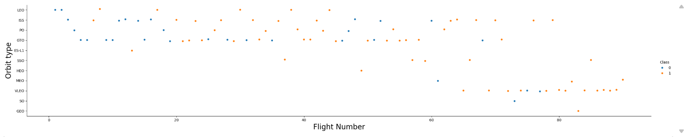
Flight Number vs. Orbit Type
Explanation
This scatter plot shows how orbit type varies with Flight Number, with colors indicating landing outcomes (blue = failure, orange = success).
The chart helps identify which orbits are more likely to result in successful landings. Higher-risk orbits like GTO and PO show mixed success, while missions to LEO and ISS display more consistent successful outcomes. We also see improvement over time—later flight numbers tend to have more successful (orange) results across multiple orbit types.

Slide 27
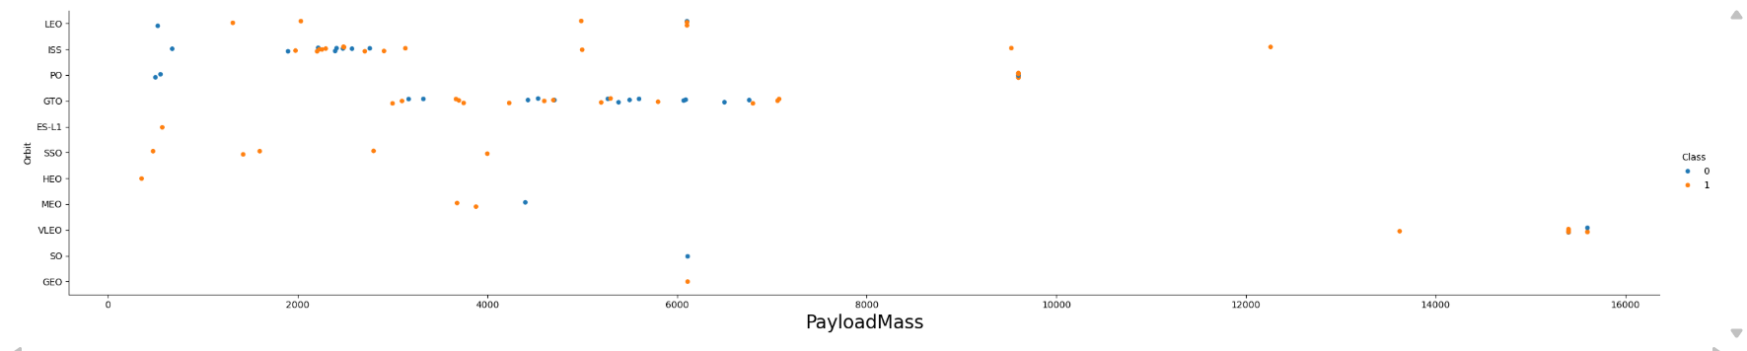
Payload vs. Orbit Type
Explanation
This scatter plot shows how payload mass relates to different orbit types, with colors representing landing success (orange) and failure (blue). Heavier payloads tend to be sent to higher-energy orbits like GTO and GEO, where success rates are slightly lower. Lighter payloads going to LEO and ISS show more consistent successful landings. This helps identify how orbit choice and payload size influence mission outcomes.

Slide 28
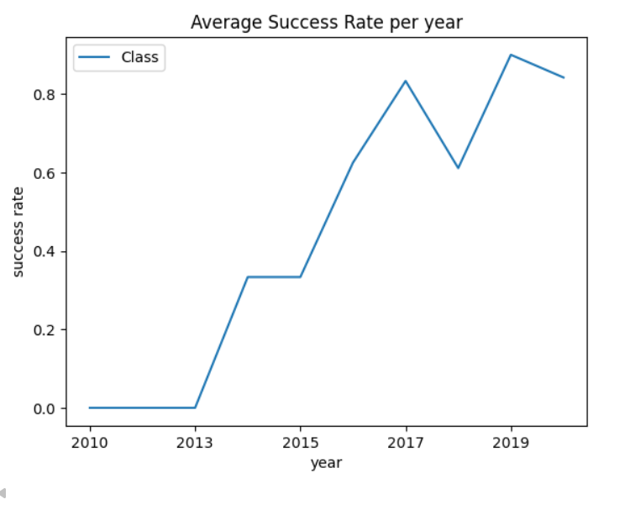
Launch Success Yearly Trend
Average Success Rate per Year – Key Insights
Success rate remained 0% from 2010 to 2013.
A noticeable improvement occurred in 2014, rising to about 33%.
Success rate stayed stable in 2015 at the same level.
A strong upward trend started in 2016, reaching over 60%.
The peak growth happened in 2017, hitting above 80%.
A slight dip occurred in 2018, dropping to around 60%.
2019 saw the highest success rate, reaching close to 90%.
Small decline in 2020, but success rate still remained above 80%.
Overall trend shows a significant long-term increase in mission success over the decade.

Slide 29
All Launch Site Names
1. CCAFS SLC-40
Full form: Cape Canaveral Air Force Station – Space Launch Complex 40 Why important:
One of SpaceX’s most frequently used launch sites.
Used for many Commercial Resupply Services (CRS) missions to the ISS.
Helps analyze success patterns because it has a large number of historical launches.
2. KSC LC-39A
Full form: Kennedy Space Center – Launch Complex 39A Why important:
A historic NASA pad originally used in Apollo and Space Shuttle missions.
Leased by SpaceX for Falcon 9 and Falcon Heavy launches.
Often shows higher success rates due to better infrastructure.
3. VAFB SLC-4E
Full form: Vandenberg Air Force Base – Space Launch Complex 4E Why important:
Used for polar orbit missions (e.g., Earth observation satellites).
Fewer launches, but useful for comparing success rates across different mission types and geographical locations.

Slide 30
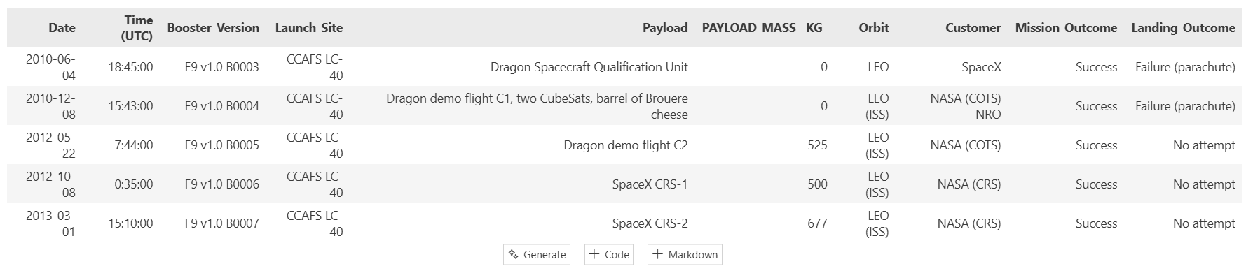
Launch Site Names Begin with 'CCA'
All 5 records with launch sites starting with “CCA” refer to the same site: CCAFS LC-40. This launch pad at Cape Canaveral is one of SpaceX’s primary sites, especially for early Falcon 9 missions and cargo resupply flights.

Slide 31
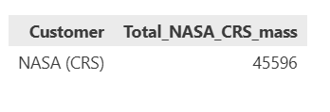
Total Payload Mass
Explanation of Query Result
The query filtered missions where the customer is NASA (CRS) and summed the payload masses of those launches. The result shows that NASA (CRS) missions have transported a total payload mass of 45,596 kg using SpaceX boosters. This highlights the significant amount of cargo delivered to support NASA’s Commercial Resupply Services program.

Slide 32
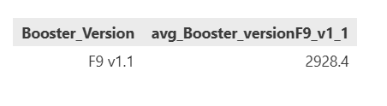
Average Payload Mass by F9 v1.1
Explanation of Query Result
The query filtered missions for Booster Version F9 v1.1 and calculated the average payload mass across those launches. The result shows that F9 v1.1 boosters carry an average payload mass of 2,928.4 kg. This highlights the typical load capacity of this booster version and helps compare its performance with other Falcon 9 variants.

Slide 33
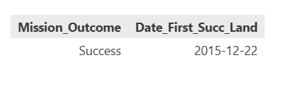
First Successful Ground Landing Date
Explanation of Query Result
The query identified the first successful ground landing of a SpaceX booster by filtering missions with a successful landing outcome and extracting the earliest landing date. The result shows that the first successful ground landing occurred on December 22, 2015. This milestone marks a major achievement in SpaceX’s reusable rocket program, significantly reducing launch costs and advancing sustainable spaceflight operations.

Slide 34
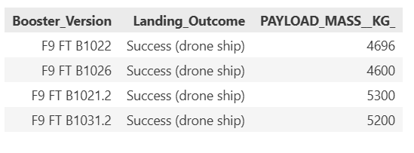
Successful Drone Ship Landing with Payload between 4000 and 6000
Explanation of Query Result
The query filtered missions with a successful drone ship landing and a payload mass between 4000 kg and 6000 kg. The result lists four booster versions — F9 FT B1022, F9 FT B1026, F9 FT B1021.2, and F9 FT B1031.2 — that successfully landed on a drone ship while carrying payloads within this range. This highlights SpaceX’s reliability in recovering boosters even under medium–heavy payload conditions.

Slide 35
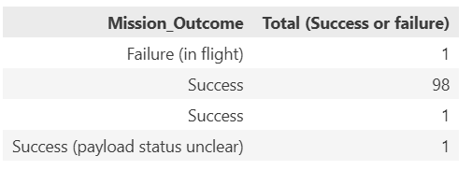
Total Number of Successful and Failure Mission Outcomes
Explanation of Query Result
The query calculated the total number of missions based on their outcomes (success or failure). The results show that SpaceX achieved an overwhelming majority of successful missions, with 98 successful launches and only 1 failure in flight. A small number of missions also had outcomes recorded as “Success (payload status unclear)”, which indicates that while the launch was successful, the final payload status could not be fully confirmed.

Slide 36
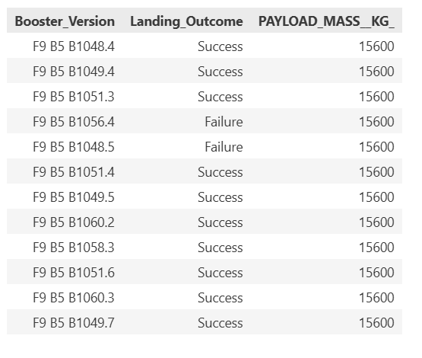
Boosters Carried Maximum Payload
Explanation of Query Result
The query identified booster missions that carried the maximum payload mass of 15,600 kg. The results show that several Falcon 9 Block 5 boosters — such as B1048.4, B1049.4, B1051.3, and B1060.3 — successfully handled this maximum payload.
Although most of these missions resulted in a successful landing, a few boosters like B1056.4 and B1048.5 experienced landing failures despite carrying the same maximum payload. This indicates that while these boosters are capable of lifting heavy payloads, landing success can still vary due to mission conditions and other operational factors.

Slide 37
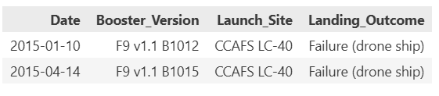
2015 Launch Records
Explanation of Query Result
The query filtered all 2015 launch records and extracted missions where the booster failed to land on a drone ship. The result shows two such missions:
On January 10, 2015, booster F9 v1.1 B1012 failed its drone ship landing after launching from CCAFS LC-40.
On April 14, 2015, booster F9 v1.1 B1015 also failed its drone ship landing from the same launch site, CCAFS LC-40.
This highlights the early challenges SpaceX faced with drone ship landings during 2015 while developing and improving reusable rocket technology.

Slide 38
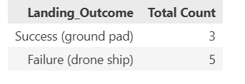
Rank Landing Outcomes Between 2010-06-04 and 2017-03-20
Explanation of Query Result
The query filtered launch missions between June 4, 2010, and March 20, 2017, and ranked landing outcomes based on their total occurrences. The results show that “Failure (drone ship)” occurred 5 times, making it the most common landing outcome during this period, while “Success (ground pad)” occurred 3 times.

Slide 39

Section 3

Slide 40
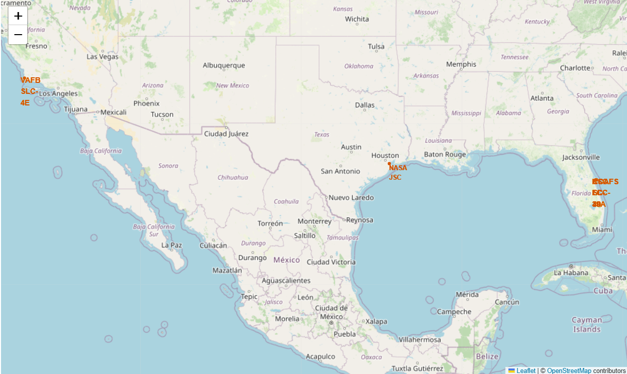
Geographical Distribution of SpaceX Launch Sites (Folium Map)
Launch Sites Shown on the Map
VAFB SLC-4E – Vandenberg Space Force Base, California
CCAFS SLC-40 – Cape Canaveral Space Force Station, Florida
KSC LC-39A – Kennedy Space Center, Florida
NASA Johnson Space Center (JSC) – Houston, Texas (reference location)
Key Observations & Findings
Coastal Location Strategy Most launch sites are positioned along the U.S. coastline (California and Florida), minimizing risks from launch debris and allowing safe rocket trajectories over the ocean.
Eastern vs Western Coverage SpaceX has launch capabilities on both U.S. coasts:
West Coast: Polar and sun-synchronous orbits (Vandenberg).
East Coast: Equatorial and geostationary orbits (Florida).
Proximity to NASA JSC The map also shows NASA’s Johnson Space Center in Texas to provide spatial context for control and coordination with NASA’s operations.
Clustering in Florida Two major launch pads (CCAFS SLC-40 and KSC LC-39A) are clustered in Florida, showing its importance as SpaceX’s primary launch hub.

Slide 41
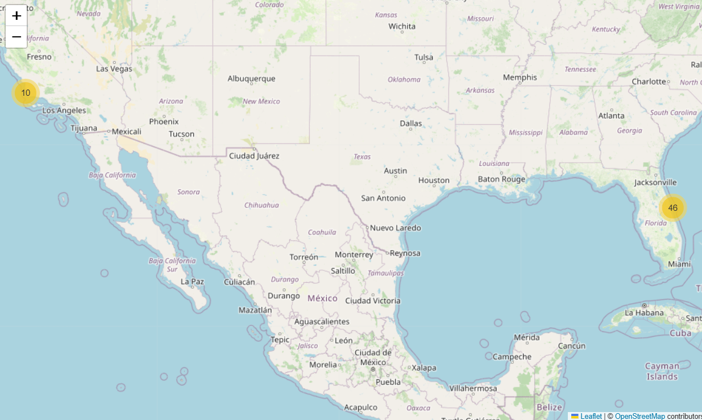
Mapping Launch Success And Failure Outcome
Brief Explanation: This map visualizes all SpaceX launch records by marking each launch location with color-coded markers. Green markers represent successful launches (class = 1), while red markers indicate failed launches (class = 0). Marker clustering is used to manage overlapping launches occurring at the same site, making the map clearer and easier to interpret.

Slide 42
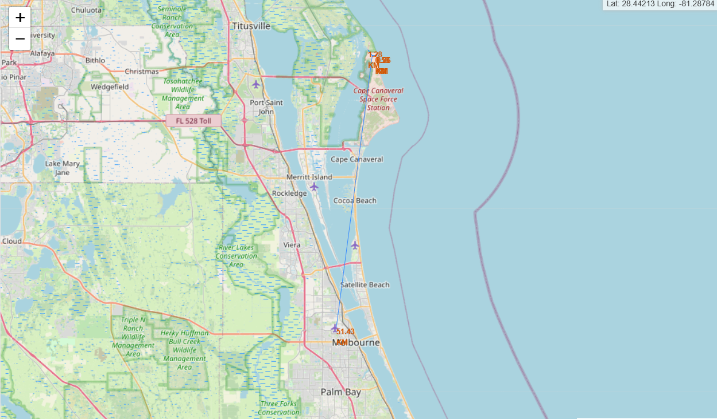
Launch Site Proximity Analysis using Folium Mapping
Explanation:
This visualization shows the selected SpaceX launch site and its nearest highway, railroad, and city, with the distances calculated using geographic coordinates. Each proximity point is marked on the map, and a connecting line is drawn from the launch site to help understand accessibility, logistics, and safety considerations. The distances (0.58 km to highway, 1.28 km to railroad, and 51.43 km to the nearest city) are displayed directly on the map using custom Folium markers. This analysis helps evaluate how well the launch site is connected to essential transportation and urban infrastructure.

Slide 43

Section 4

Slide 44
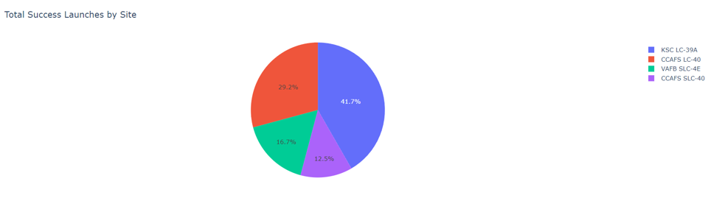
Distribution of Successful Launches Across SpaceX Sites
Explanation:
This chart highlights how successful launches are distributed among the four major SpaceX launch sites. The pie chart shows that KSC LC-39A accounts for the largest share of successes at 41.7%, making it the most reliable and frequently used site. CCAFS LC-40 follows with 29.2%, while VAFB SLC-4E and CCAFS SLC-40 contribute 16.7% and 12.5% respectively.
Overall, the visualization provides a clear overview of which launch sites have been most successful historically, helping identify SpaceX’s key operational hubs.

Slide 45
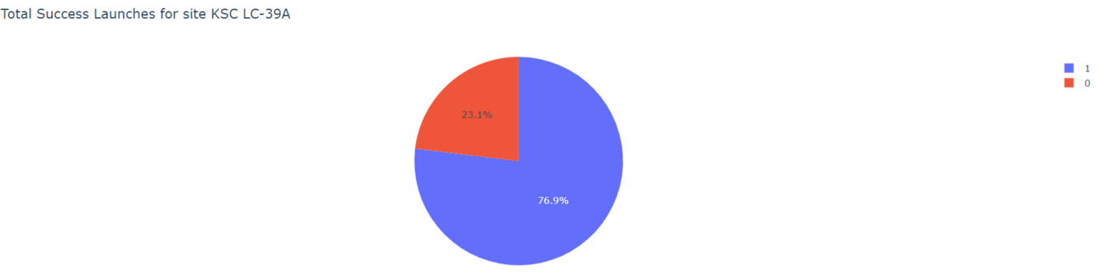
Success vs Failure Breakdown for the Most Reliable Launch (KSC LC-39A)
Explanation:
This pie chart illustrates the performance of KSC LC-39A, the launch site with the highest overall success ratio among all SpaceX sites. The chart shows that 76.9% of launches from this site were successful (Class 1), while 23.1% resulted in failure (Class 0).
The strong dominance of successful launches highlights LC-39A’s operational reliability, stability, and effectiveness as a primary launch facility. Its consistently high success percentage makes it a crucial site in SpaceX’s mission operations.

Slide 46
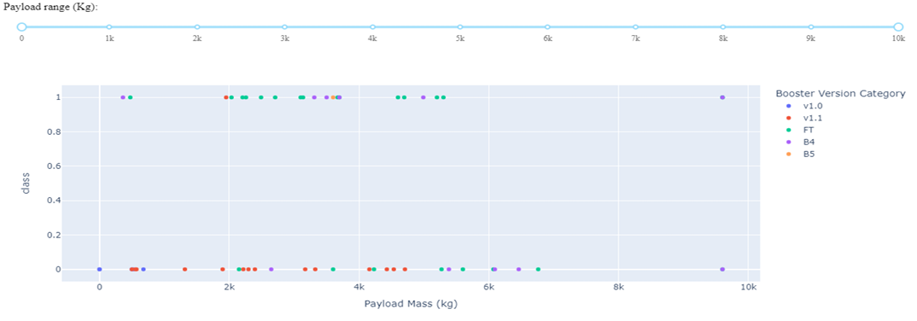
Relationship Between Payload Mass and Launch Outcome
Explanation:
The scatter plot compares payload mass with launch outcomes across different booster versions. From the visualization, the FT booster version shows a higher concentration of successful launches, even at higher payload masses, indicating strong performance and reliability. In contrast, the v1.1 booster version exhibits more failures, especially as payload mass increases.
This plot helps illustrate how booster technology impacts success rates and shows that newer or upgraded boosters tend to handle heavier payloads more effectively.

Slide 47

Section 5

Slide 48
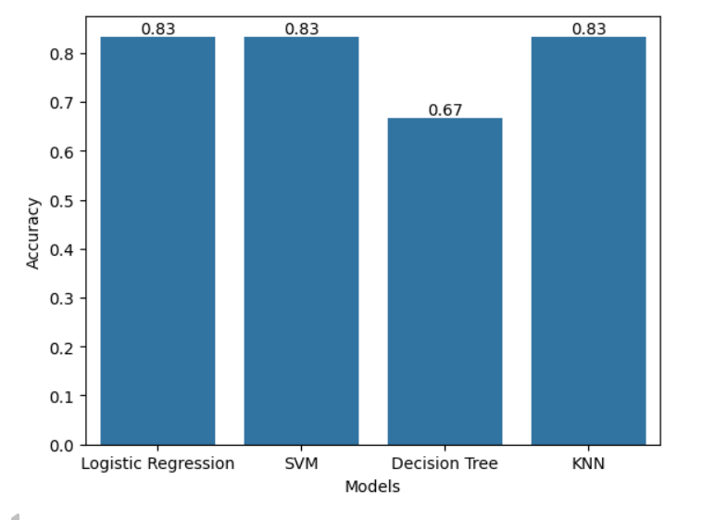
Classification Accuracy
Explanation: This slide presents a comparison of the accuracy achieved by four different machine-learning classification models used to predict Falcon 9 landing outcomes. The bar chart visualizes each model’s accuracy score, making it easy to identify which algorithm performed best.
From the results:
Logistic Regression, SVM, and KNN all achieved an accuracy of 0.83, making them the top-performing models.
The Decision Tree model performed comparatively lower with an accuracy of 0.67.
This comparison helps in selecting the most reliable model for predicting launch success.

Slide 49
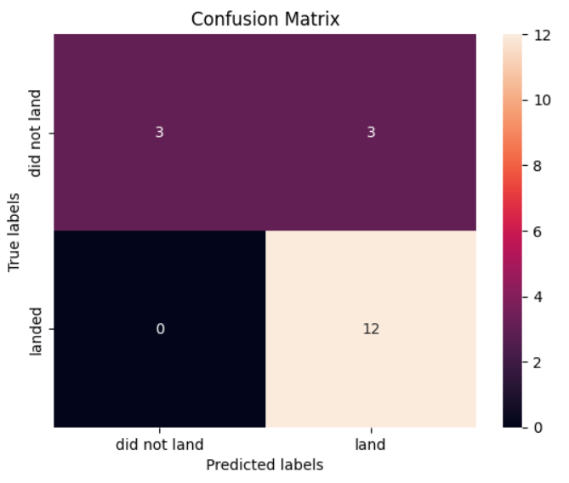
Confusion Matrix
Explanation: The confusion matrix illustrates how well the KNN model classified the two outcomes — landed and did not land.
True Positives (12): The model correctly predicted “landed” when the booster actually landed.
True Negatives (3): The model correctly predicted “did not land” when the booster truly did not land.
False Positives (3): The model predicted “land” even though the booster did not land.
False Negatives (0): The model made no mistakes predicting “did not land” when it actually landed.
Overall, the model achieves:
Accuracy: 0.83
Precision: 0.80
Recall: 1.00
F1-score: 0.8148
This shows that the model is very reliable at identifying successful landings and makes no false negatives, which is important for mission safety analysis.

Slide 50
Conclusions
The project successfully used machine-learning models to predict whether a Falcon 9 booster will land successfully.
Logistic Regression, SVM, and KNN achieved the highest accuracy (0.83), showing strong performance across models.
KNN was selected as the best-performing model, providing high recall and balanced precision, making it reliable for predicting successful landings.
The confusion matrix showed that the model can accurately identify landings with zero false negatives, which is critical for mission planning and cost analysis.
Overall, the models provide valuable insights for SpaceX’s cost-efficiency strategy, helping estimate booster reusability and mission success probabilities.

Slide 51
Appendix
Dataset Source: SpaceX launch data collected through API queries and web scraping from official SpaceX records and public datasets.
Features Used: Includes parameters such as booster version, payload mass, launch site, orbit type, grid fins, legs, flight number, and reused components.
Models Implemented: Logistic Regression, Support Vector Machine (SVM), Decision Tree, k-Nearest Neighbors (KNN).
Evaluation Metrics: Accuracy, Jaccard score, Precision, Recall, F1-score, and Confusion Matrix visualizations.
Preprocessing Steps: Handling missing values, one-hot encoding of categorical variables, feature scaling, and train–test splitting.
Tools & Libraries: Python, Pandas, NumPy, Scikit-learn, Seaborn, Matplotlib, Folium, and Jupyter Notebook.
Hyperparameter Tuning: GridSearchCV applied to optimize classifier performance.
Visualization Outputs: Maps showing launch site proximities, bar charts of model performance, and confusion matrices.

Slide 52


